Slide 1
Detecting Fake News with Python

Slide 2
What is Fake News?
A type of yellow journalism, fake news encapsulates pieces of news that may be hoaxes and is generally spread through social media and other online media. This is often done to further or impose certain ideas and is often achieved with political agendas. Such news items may contain false and/or exaggerated claims, and may end up being viralized by algorithms, and users may end up in a filter bubble.

Slide 3
What is a TfidfVectorizer?
TF (Term Frequency): The number of times a word appears in a document is its Term Frequency. A higher value means a term appears more often than others, and so, the document is a good match when the term is part of the search terms.
IDF (Inverse Document Frequency): Words that occur many times a document, but also occur many times in many others, may be irrelevant. IDF is a measure of how significant a term is in the entire corpus.
The TfidfVectorizer converts a collection of raw documents into a matrix of TF-IDF features.

Slide 4
What is a PassiveAggressiveClassifier?
Passive Aggressive algorithms are online learning algorithms. Such an algorithm remains passive for a correct classification outcome, and turns aggressive in the event of a miscalculation, updating and adjusting. Unlike most other algorithms, it does not converge. Its purpose is to make updates that correct the loss, causing very little change in the norm of the weight vector.

Slide 5
Detecting Fake News with Python
– Objective
To build a model to accurately classify a piece of news as REAL or FAKE.

Slide 6
Detecting Fake News with Python
– About the Python Project
This advanced python project of detecting fake news deals with fake and real news. Using sklearn, we build a TfidfVectorizer on our dataset. Then, we initialize a PassiveAggressive Classifier and fit the model. In the end, the accuracy score and the confusion matrix tell us how well our model fares.

Slide 7
The Dataset
The dataset we’ll use for this python project- we’ll call it news.csv. This dataset has a shape of 7796×4. The first column identifies the news, the second and third are the title and text, and the fourth column has labels denoting whether the news is REAL or FAKE. The dataset takes up 29.2MB of space and you can download it here.

Slide 8
Advanced Python Project
– Prerequisites
You’ll need to install the following libraries with pip:

Slide 9
Steps for detecting fake news with Python
Follow the below steps for detecting fake news and complete your first advanced Python Project –

Slide 10
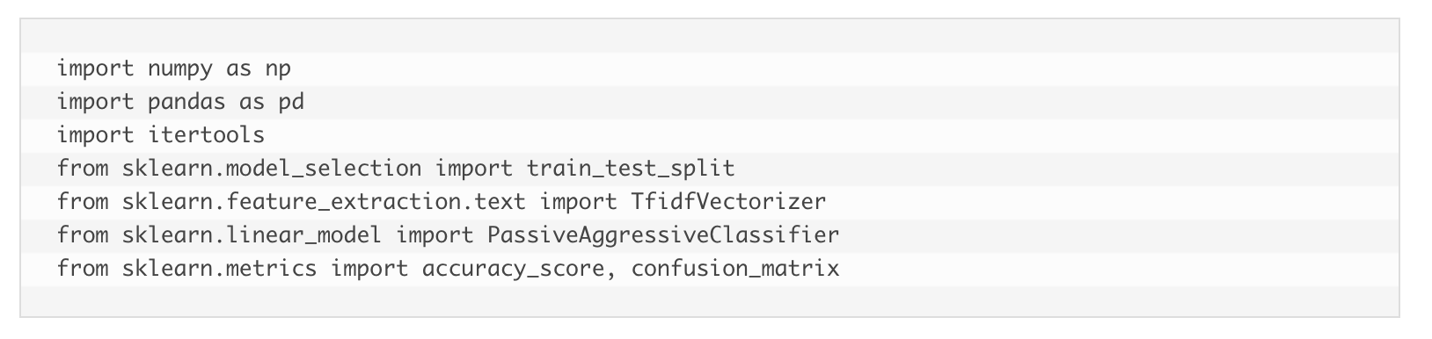
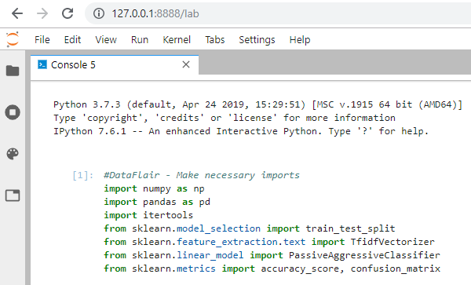

Slide 11
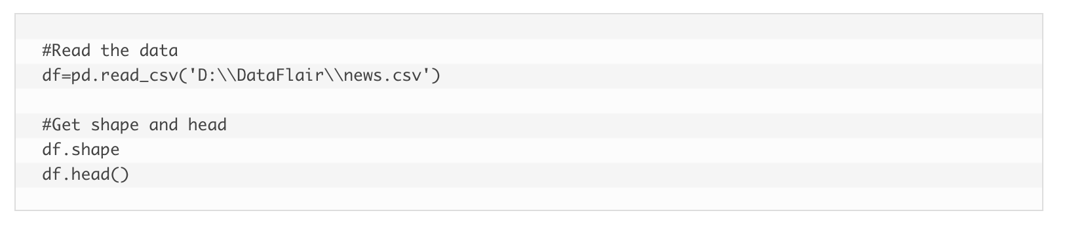
Now, let’s read the data into a DataFrame, and get the shape of the data and the first 5 records.

Slide 12
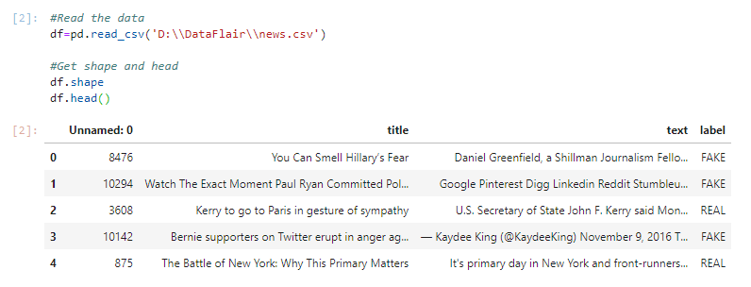

Slide 13
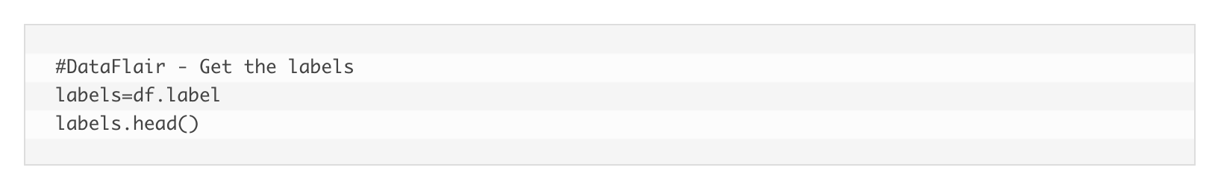
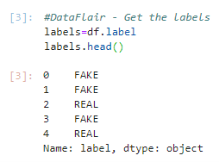
3. And get the labels from the DataFrame.

Slide 14
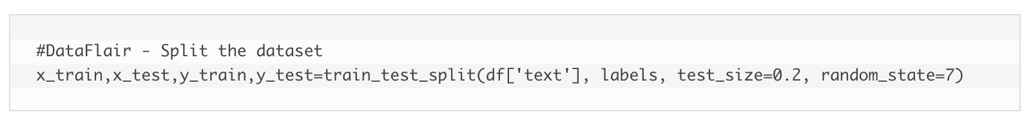
4. Split the dataset into training and testing sets.

Slide 15
5. Let’s initialize a TfidfVectorizer with stop words from the English language and a maximum document frequency of 0.7 (terms with a higher document frequency will be discarded). Stop words are the most common words in a language that are to be filtered out before processing the natural language data. And a TfidfVectorizer turns a collection of raw documents into a matrix of TF-IDF features.

Slide 16
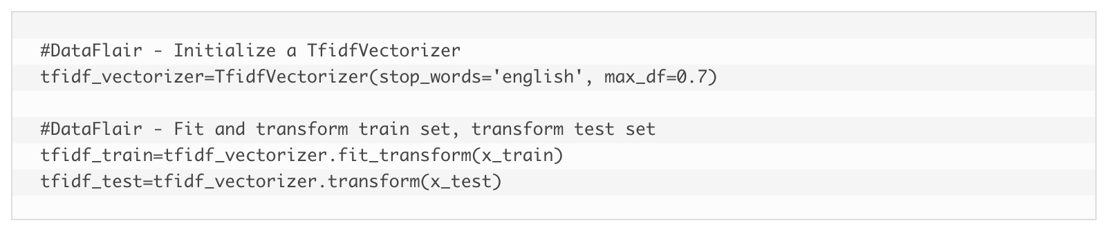
Now, fit and transform the vectorizer on the train set, and transform the vectorizer on the test set.

Slide 17
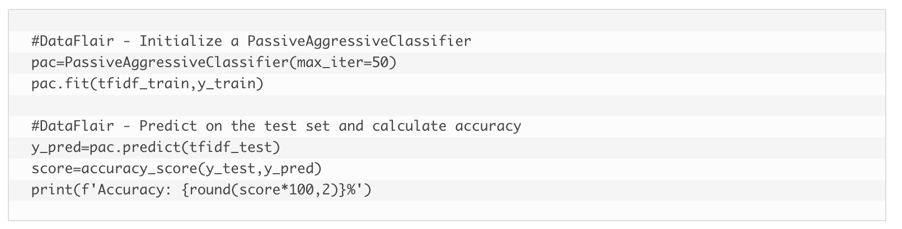
6. Next, we’ll initialize a PassiveAggressiveClassifier.
This is. We’ll fit this on tfidf_train and y_train.
Then, we’ll predict on the test set from the TfidfVectorizer and calculate the accuracy with accuracy_score() from sklearn.metrics.

Slide 18
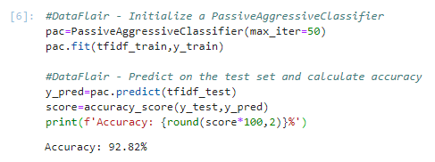

Slide 19
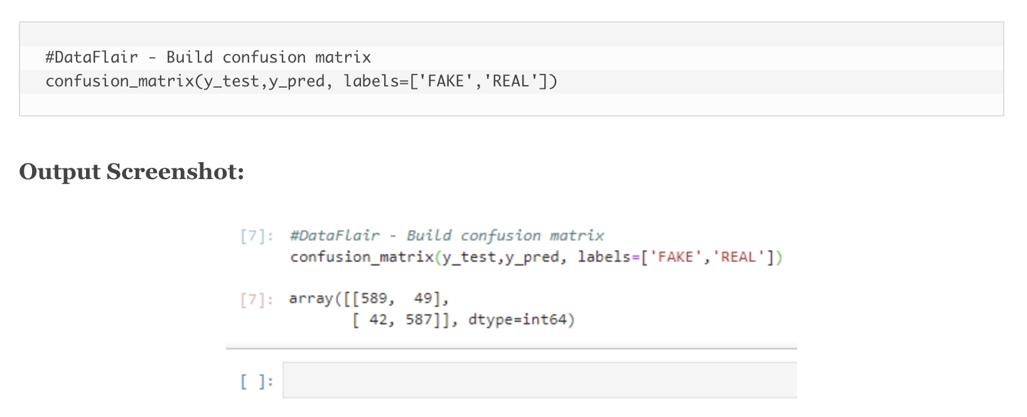
7. We got an accuracy of 92.82% with this model. Finally, let’s print out a confusion matrix to gain insight into the number of false and true negatives and positives.
So with this model, we have
589 true positives,
587 true negatives,
42 false positives,
49 false negatives.

Slide 20
Summary
Today, we learned to detect fake news with Python. We took a political dataset, implemented a TfidfVectorizer, initialized a PassiveAggressiveClassifier, and fit our model. We ended up obtaining an accuracy of 92.82% in magnitude.
Hope you enjoyed our first advanced level Python Project. Keep visiting DataFlair for more interesting Python data science and machine learning projects.

Slide 21
Reference
https://data-flair.training/blogs/advanced-python-project-detecting-fake-news/

